Slide 1

FuseBuster
Detection of faults in Electrical lines

Slide 2



Problem statement
Electrical lines are vulnerable to faults which go unnoticed for days. This may result in delay in maintenance and discomfort and issues for end users. Hence, the proposed solution is aims to create a cluster of modules to find the location of fault. It aims at returning the GPS coordinates of the probable fault location

Slide 3




Recent Issues of Power outage

Slide 4
COST OF ELECTRIC OUTAGE
For large companies, the cost of an outage can escalate into the millions of dollars per hour of downtime. In fact, the DoE recently estimated that outages are costing the U.S. economy $150 billion annually.
The annual cost of power interruptions:
Could be as low as $22 billion or as high as $135 billion
Could be as high as $119 billion

Slide 5

Principle
Electromagnetic Induction

Slide 6


Slide 7


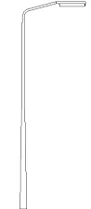


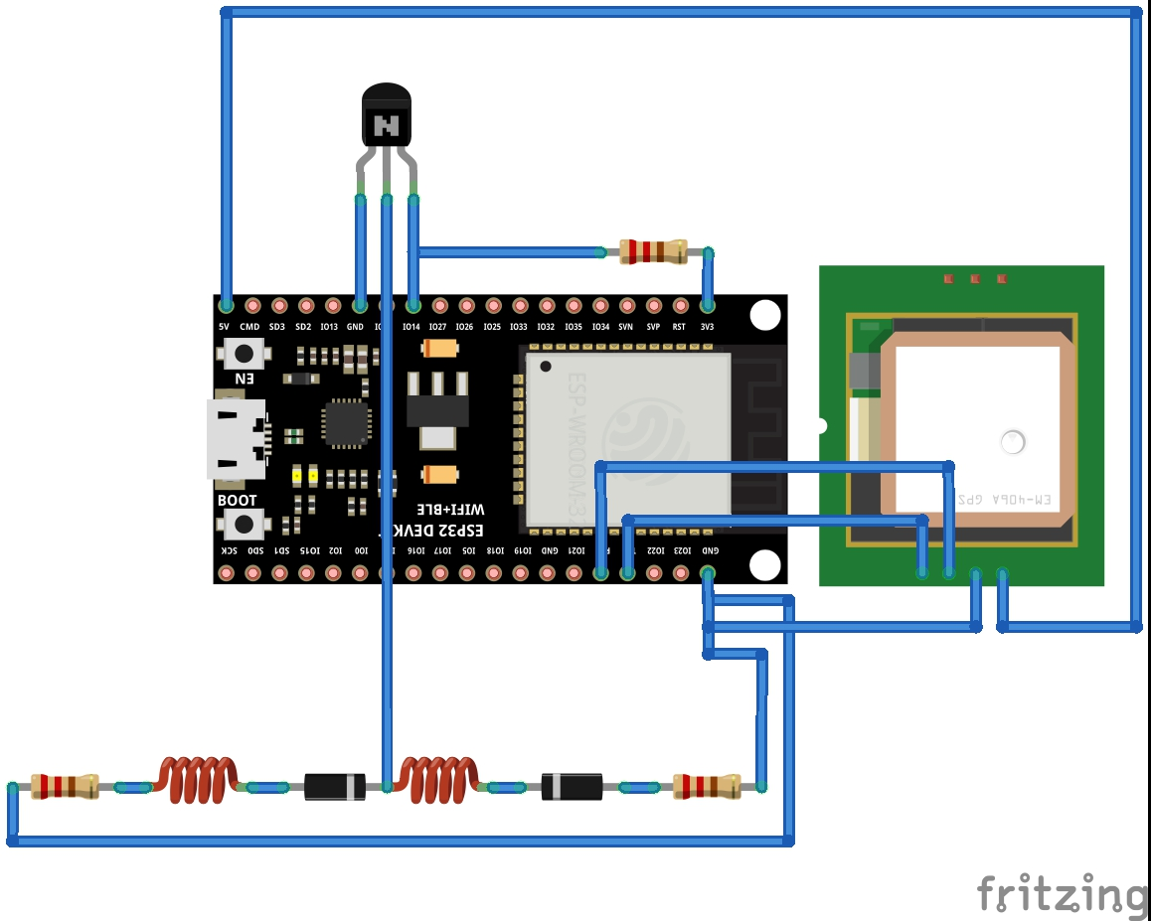

REPRESENTATION
LIGHT POLE
Cellular data
ELECTRICITY DEPARTMENT
Power failure
HTTPS request
FUSE-BUSTER
LOCATION AT FAULT

Slide 8
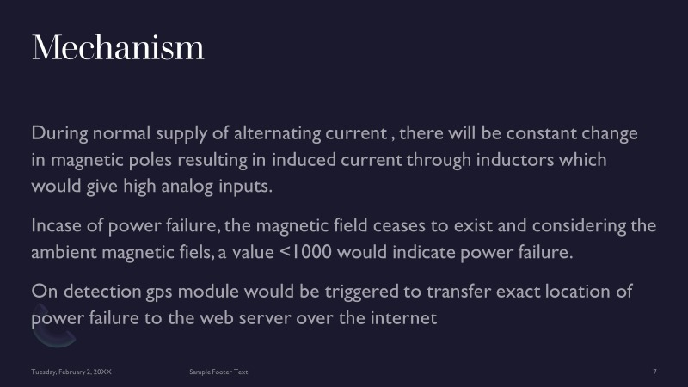

Slide 9
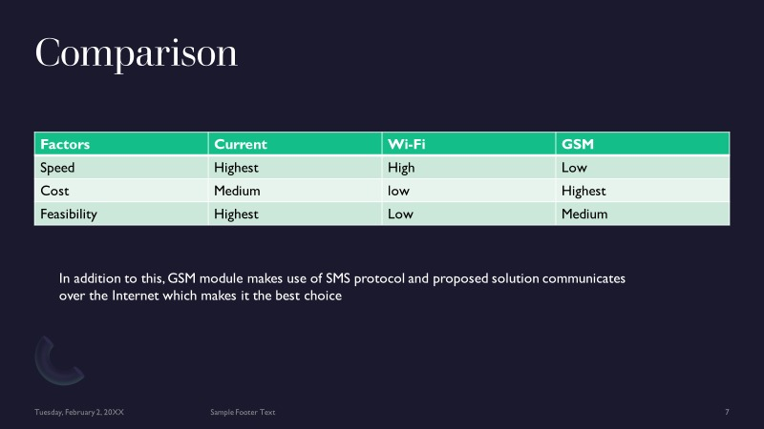

Slide 10
Principle
Every electric line generates an induced electromagnetic field around itself. These electromagnetic fields can be used to detect whether the electric line is working or not. An ESP32 or ESP8266 module interfaced with an inductor can be used to detect the presence of the electric field. They can further be interfaced with a GPS module and can send the information to the server over the internet.

Slide 11
Proposed circuit diagram

Slide 12

Summary
A cluster of the proposed module, when placed at regular intervals near the electric lines can detect any change in EMF. These can be further used to detect a sudden surge or a line failure. These can be reported with GPS coordinates to the authorized personnel in no time, so that immediate action can be taken.

Slide 13


Thank You

